Slide 1
MBC Fraud Analysis
Di Yang , Shiyu Zhang, Yiwen Zhang, Lujing Yao

Slide 2
Company Background

Slide 3
MBC Business
MBC earns revenue in each of the four phases of the mortgage banking process: origination, warehousing, marketing, and servicing, and other business activities.
Origination
Revenue: fees paid by the borrower upon applying for a loan and at the loan closing.
The origination process involves providing competitive mortgage loan rates, soliciting loan applications, performing title and credit review and funding loans at closing.
Warehousing
Warehousing is the term used to describe the process of holding mortgage loans pending their sale to investors (typically financial institutions) or into the secondary market.
Income = interest received on mortgage loan - interest paid on short-term advances from bank

Slide 4
MBC Business
Servicing
Servicing fee is the source of income of the loan servicing portfolio. It generally range from 0.25% to 0.50% per year for mortgage loans and from 0.25% to 2.5% per year for land contracts.
Marketing
Matching the needs of the retail origination market with the needs of the secondary market for mortgage loans.
Other Business activities
The company is also involved in Securitization and Syndication of Real Estate Interests and Purchase and Resale of Real Property.

Slide 5
Potential Fraud on
Balance Sheet

Slide 6
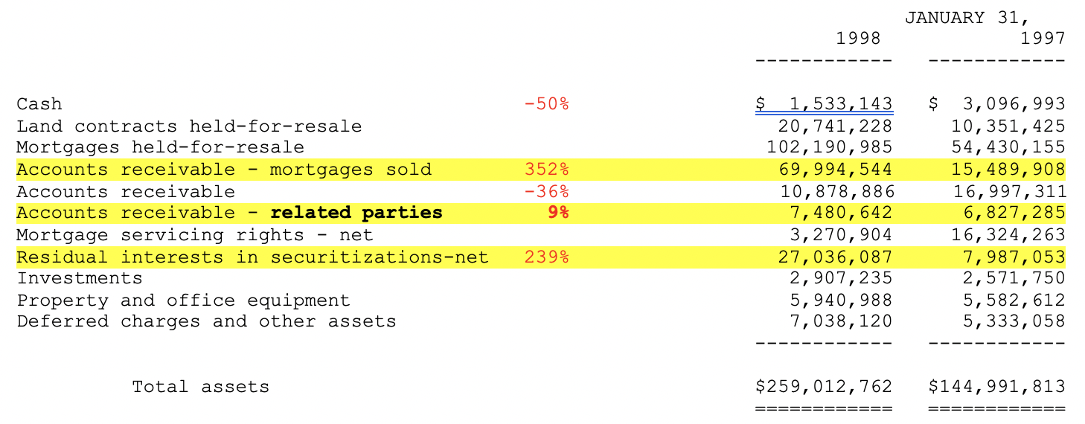
Balance Sheet Analysis---Asset

Slide 7
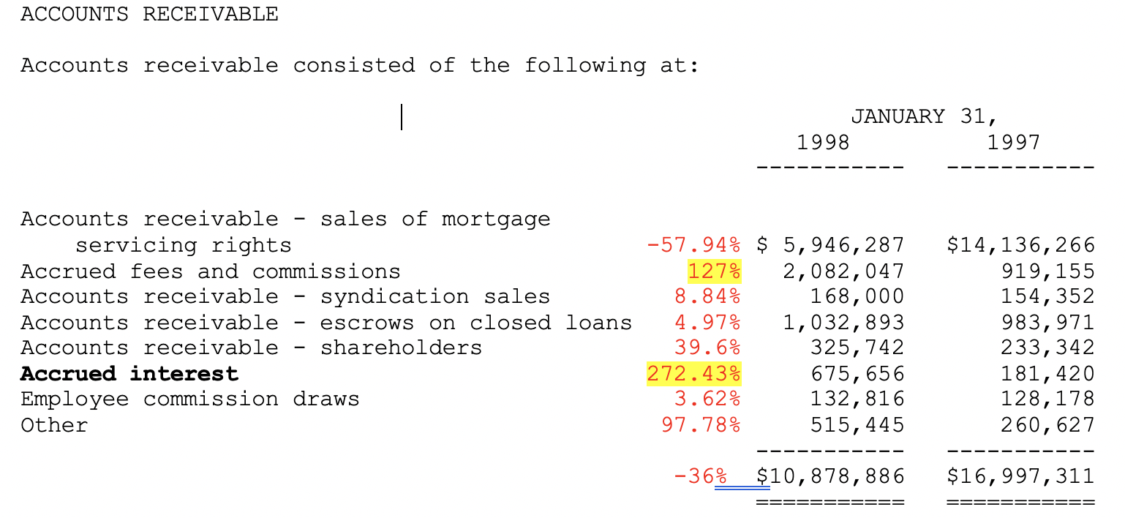

Accounts Receivable
A/R from mortgages sold increasing 352%, cash decreased 50% and there is no bad debt allowance
High risk in overstatement of A/R on Balance Sheet
Accrued interest from loan increased 272%
Accrued fees and commissions increased 127%
Revenue only change
Doesn`t align

Slide 8
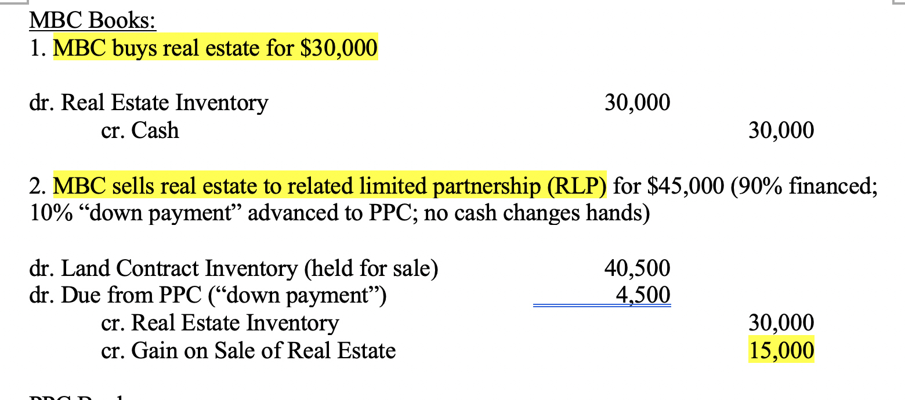

Related Parties
Two forms of related parties with MBC:
Property Pipeline Corp(PPC)
Related Limited Partnership (RLP)
3rd Party
MBC
RLP
PPC
From 1997 to 1998, all gain on sale of real estate came from related parties. We doubt that the company had potential fraud during this period.

Slide 9
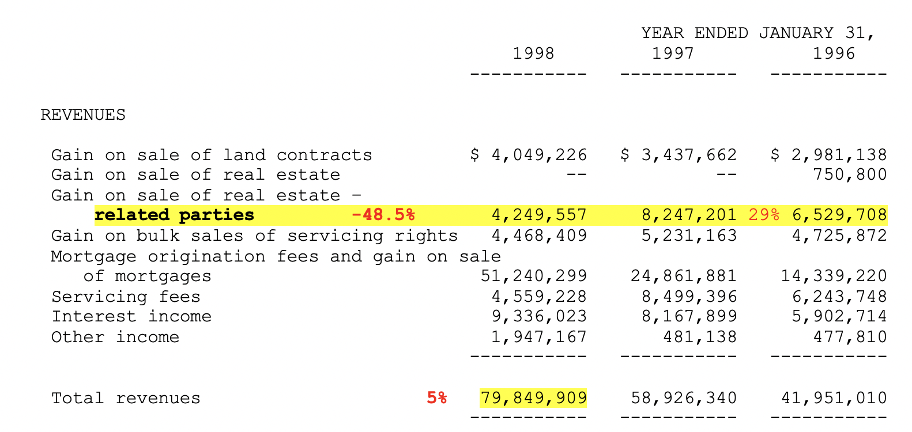
Related Parties
Gain on sales of real estate with related parties takes up 5% of Total revenue
Significant influence on A/R
Revenues from related parties decrease 48.5% in 1998
A/R from related parties increased 9%

Slide 10
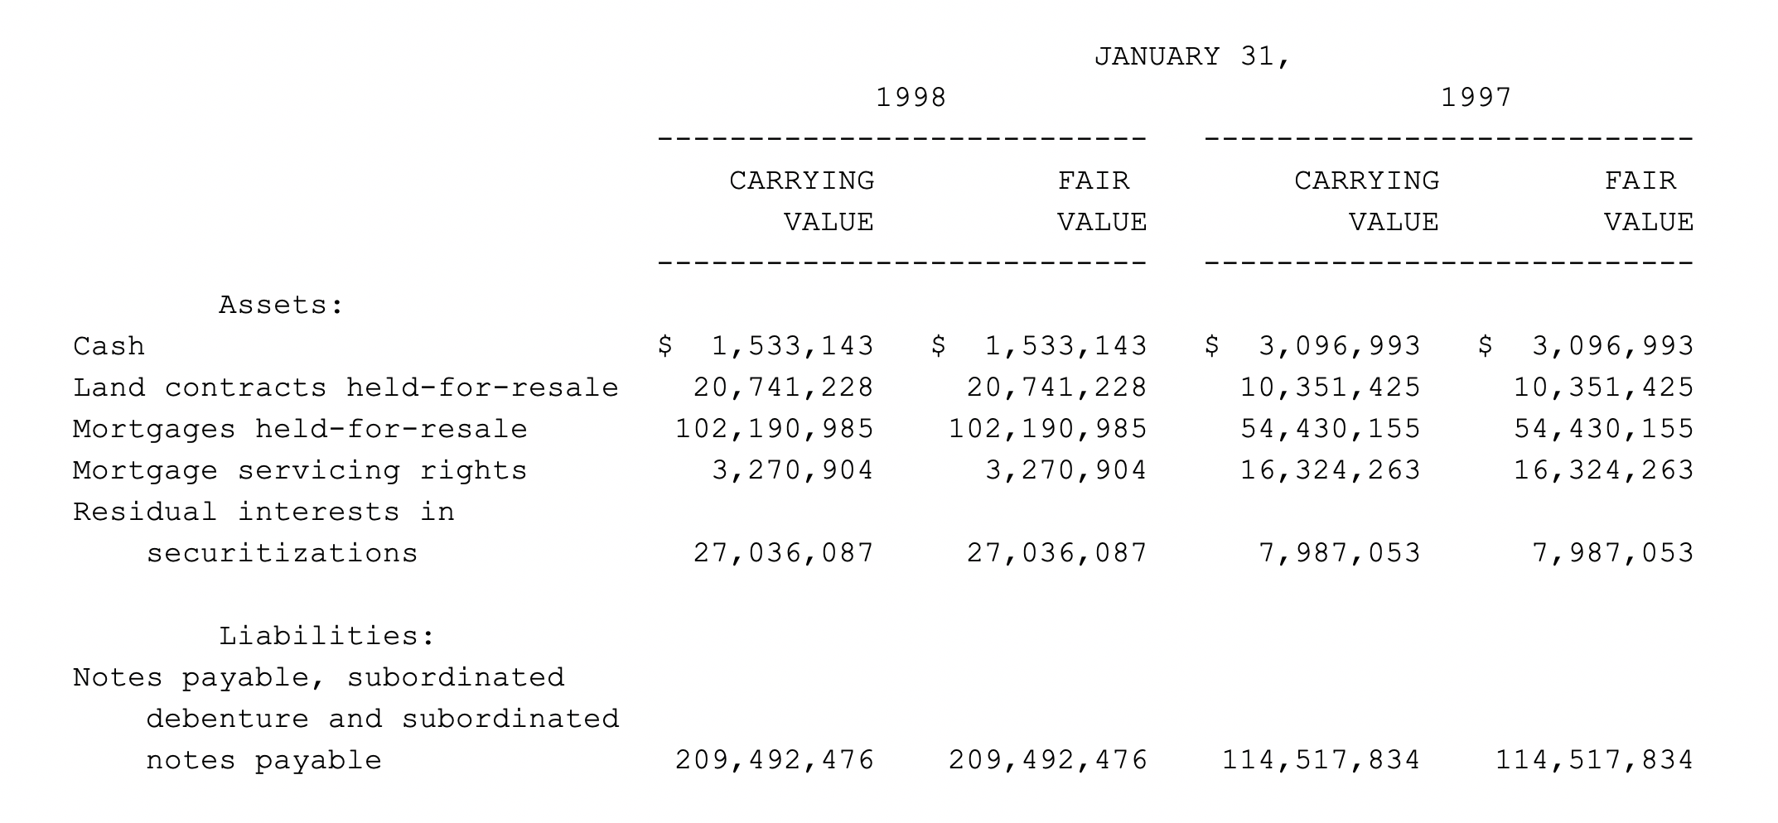
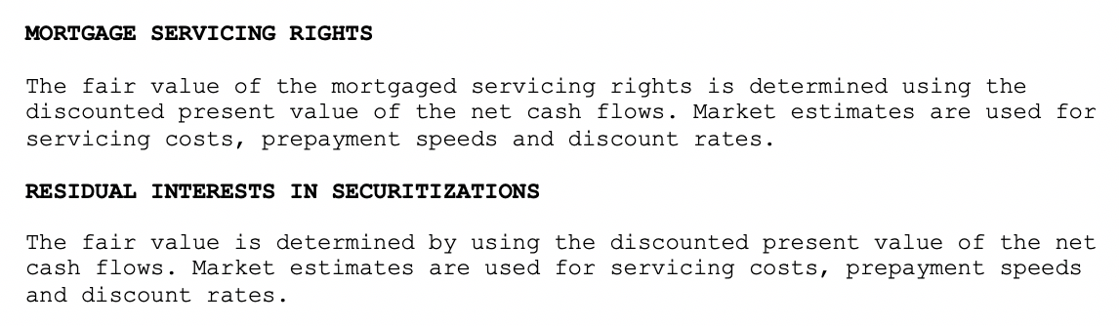
Financial Instrument Measurement
Same?
Overstatement of Assets?
Considering the fair value is discounted from expected future cash flow, it should be somehow lower than the carrying value of the financial instrument.

Slide 11
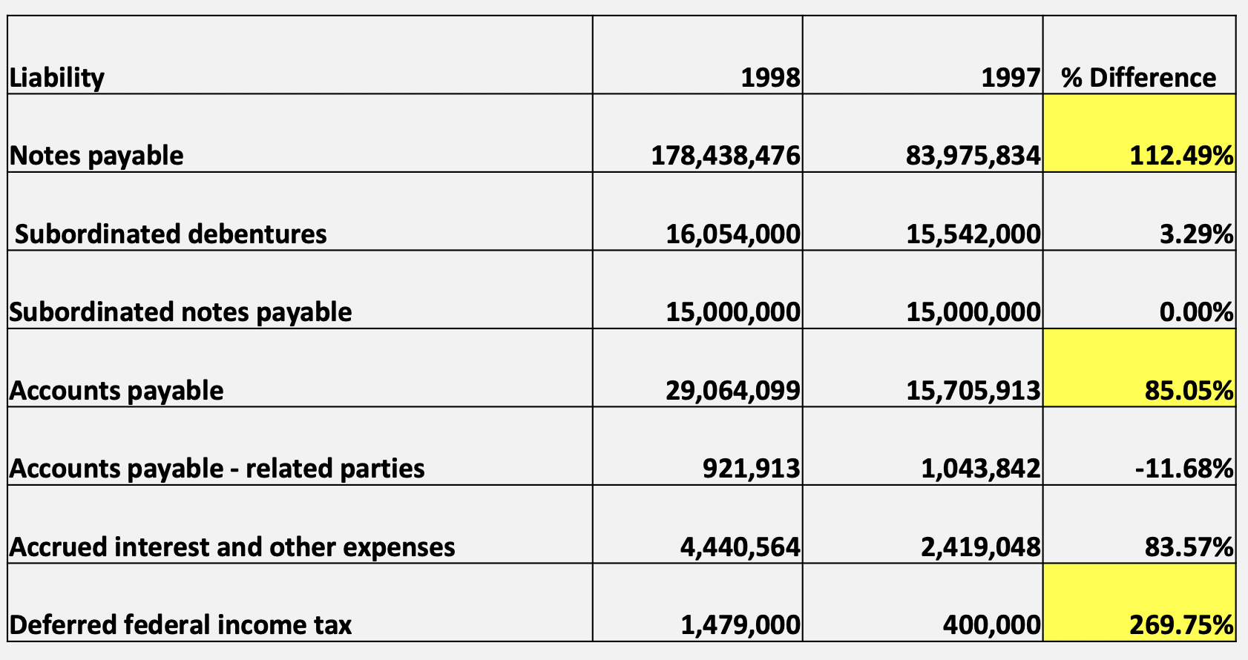
Balance Sheet Analysis---Liability

Slide 12
D/E Ratio
 | 1998 | 1997
Debt/Equity | 18.4 | 12.59
Total Liability | 245,398,052 | 134,086,637
Total Equity | 13,336,449 | 10,648,803
46.13% increase in D/E ratio
VS
35.5% increase in Revenue
D/E ratio is way too high compared to a reasonable level of 1-1.5, the company is over relying on financial leverage.
Is it a reasonable borrowing increasing rate?

Slide 13
Potential Fraud on Income Statement

Slide 14

Net Income and EPS
1997 1998
Overstated?
Diluted EPS increased by 617.9%
Net income increased by 269.8%
Notes:
We would like to do some further analysis about more detailed income items to see if there is potential fraud in the net income statement.

Slide 15
Gain on Sale of Real Estate
The Chairman of the Board of BCRI is a member of the Board of MBC
Not included in the related parties’ gain on sale of real estate
Related parties transaction

Slide 16
Other Income-Rental Charges
1997 1998
Overstated?
Other income attributed to rental charges increased by 261.4%
Notes:
From 1997 to 1998, other income attributable to rental charges increases by 261.4%, which arouses our attention. These rental charges was from an entity controlled by certain board members of the company which utilizes a portion of the company’s office space. Therefore, it is abnormal that the rental charge changes that much if the rental agreement stays the same. More information about the rental is needed.

Slide 17
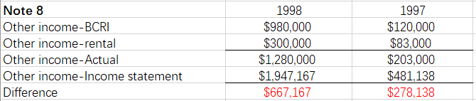
Other Income
Other sources?
/Overstated?
Other income—BCRI
Other income—Actual
Other income—Income Statement
Other income—Rental
Notes:
There are two parts of other income mentioned in the Notes, which are other income from BCRI and from rental charges. However, the total amount is not equal to the amount of other income recorded in the Income statement. We need to confirm the source of the other part of other income that is not mentioned in the materials. Otherwise, other income may be overstated.

Slide 18
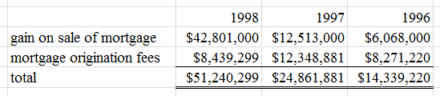
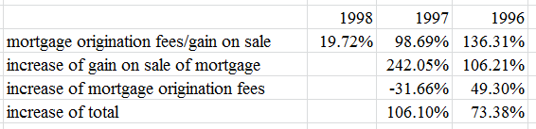
Gains and Losses from Loan Sale Transactions
Decrease of the fees
VS
Increase of gain?

Slide 19
Is it a fraud?
From the income statement, we notice that there is a rapid growth in the mortgage origination fees and gain on sale of mortgages, which are 73.38% and 106.10% separately in 1996 and 1997. In order to explore the origin of the growth, we split the total amount into the gain on sale of mortgage and mortgage origination fee.
It is unreasonable to have a decreased mortgage origination fee but a rocketing gain. This may implies a fraud—inflating the income. There is a possibility that a material large amount of loans are sold on a recourse basis and in that case the company should have not recognizes the transactions as sale. However, the company deliberately regards them as normal non-recourse sale and recognize the inflow as revenue.

Slide 20
Potential Fraud on Statement of Cash Flow

Slide 21
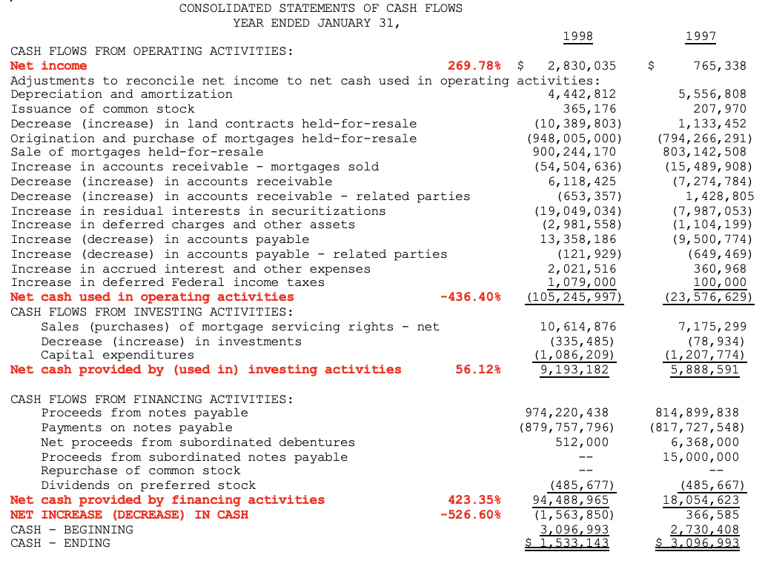
The company is borrowing more money through financing activities while still have negative increase in cash on hand.
Abnormal cash outflow (LOSS) in operating activities despite an abnormal increase in Net income.
Improper revenue/expense recognition?

Slide 22
Summary

Slide 23
Potential Fraud
Cash decreased 50%, no bad debt, abnormal accrued A/R, high risk in overstatement of A/R on Balance Sheet
Measurement of financial instrument, potential risk on overstatement of Assets
All gain on sale of real estate came from related parties, potential risk in revenue recognition with related parties
With revenue form related parties decreasing 48.5%, while A/R from related parties increased 9%, high risk in overstatement of A/R from related parties
High D/E ratio, improper usage of financial leverage

Slide 24
Potential Fraud (Cont’)
6. Rapid growth of net income and EPS from 1997 to 1998, high risk of overstatement
7. Potential understatement or misallocation of gain on sale of real estate with related parties
8. Difference exists between the actual Other income mentioned and the recorded number, risk of overstatement of Other Income
9. Unreasonable increase in the gain from loan sale compared with the decrease of the registration fee, risk of overstatement of revenue
10. High cash outflow in operation activities with high cash inflow in financing activities, improper revenue/expense recognition

